Slide 1
Techniques to secure data on cloud: Docker swarm or Kubernetes?
By Sashwat

Slide 2
What is Cloud Computing?
Introduction
A Cloud Computing model is a model which enables convenient, on demand network access to a shared pool of configurable computing resources and services.
The resources includes:-
Network
Storage
CPU cores
RAM

Slide 3
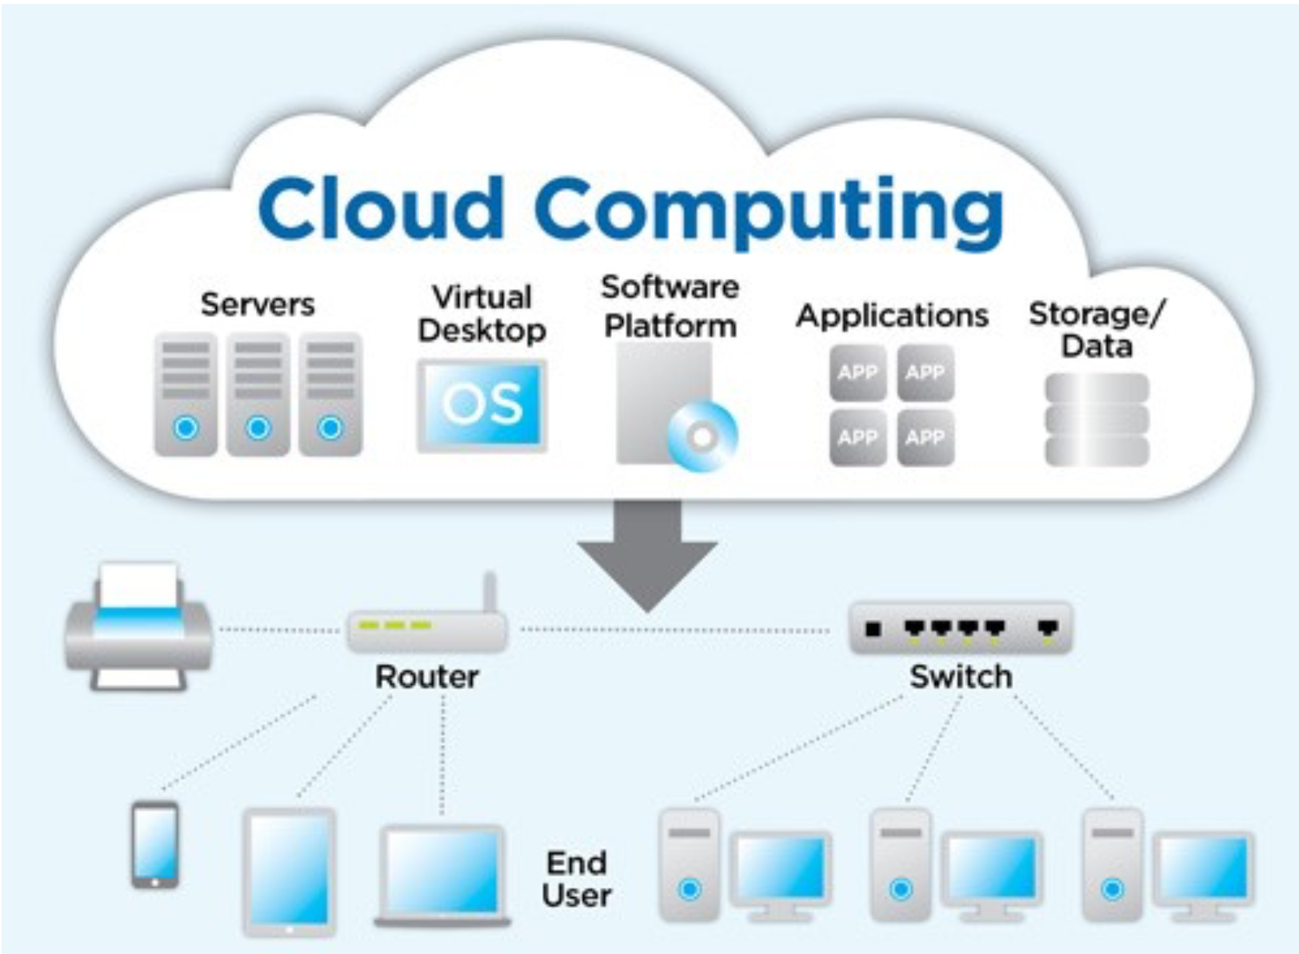

Slide 4
Cloud computing characteristics
Introduction
On-Demand self service.
Broad network access.
Resource pooling.
Rapid elasticity.
Measured service.

Slide 5
Cloud computing Service Model
Introduction
Infrastructure as a Service (IaaS)
Platform as a Service (PaaS)
Software as a Service (SaaS)

Slide 6
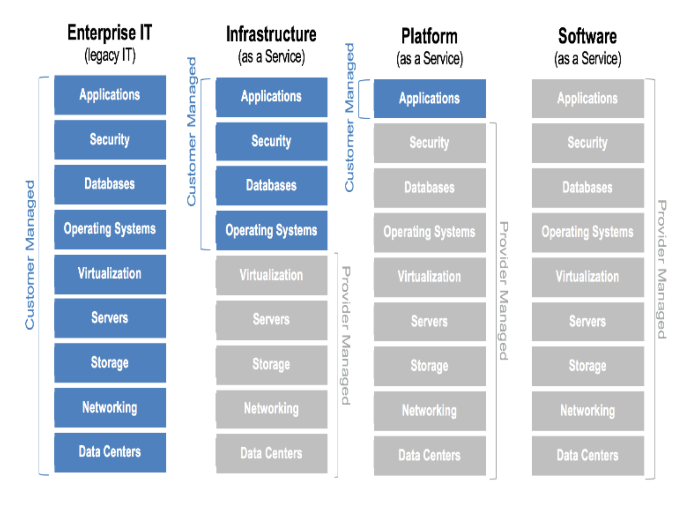

Slide 7
Cloud computing Deployment Model
Introduction
Public cloud
Private cloud
Community cloud
Hybrid cloud

Slide 8
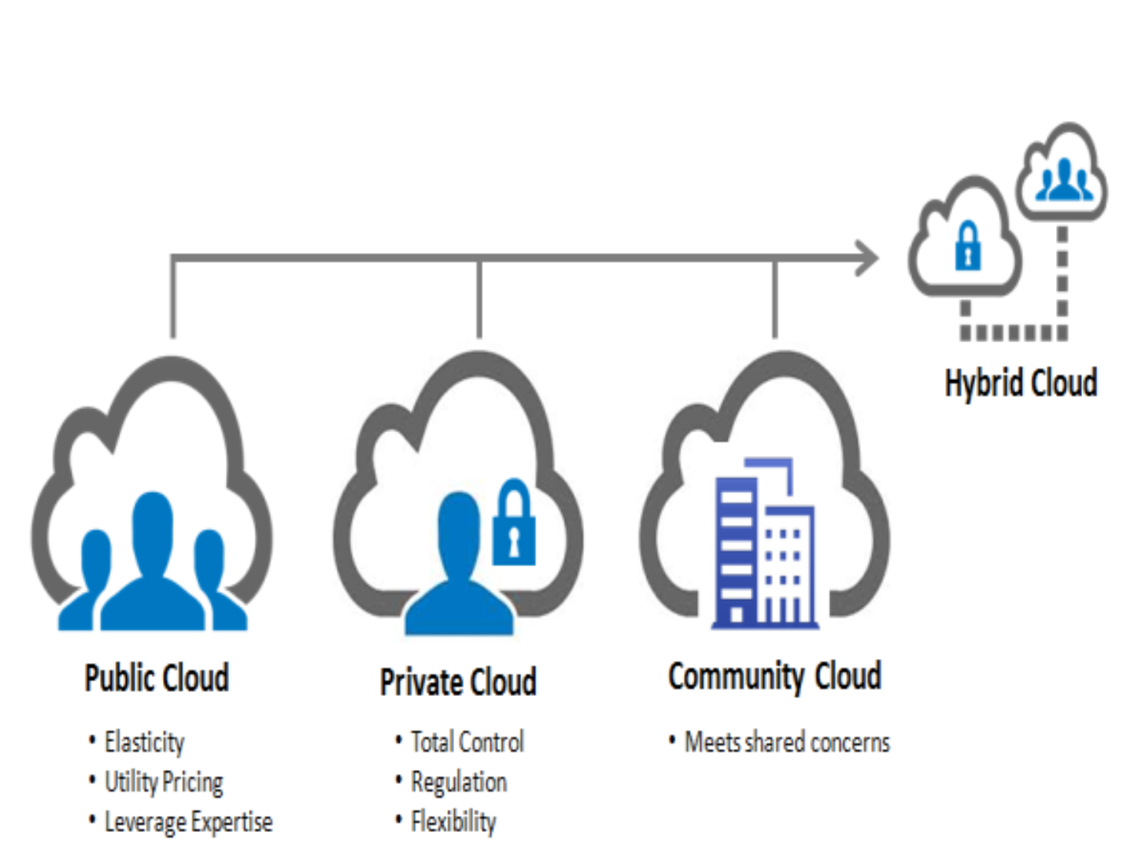

Slide 9
Cloud computing - Advantages
Introduction
Minimised cost
Higher resource sharing
Consumption based cost
Efficient power saving
Faster time to deploy new services
Management moves to the cloud provider

Slide 10
Cloud computing - Disadvantages
Introduction
Reliability
Availability
Security
Privacy
Latency
Regulatory laws

Slide 11
Security
INTRoduction
Three principles of cloud security:-
Availability
Confidentiality
Integrity
Best security method - Cryptography, RSA algorithm and Container clustering
Kubernetes and Docker swarm are technologies that use container clustering

Slide 12
What is Container?
INTRoduction
A container image is a lightweight, stand-alone, executable package of a piece of software that includes everything needed to run it: code, runtime, system tools, system libraries, settings.
It is platform independent.

Slide 13
What is Docker?
Introduction
Docker is a set of platform-as-a-service products that use OS-level virtualisation to deliver software in packages called containers.
Core DevOps tool.
Docker is the next step from virtualisation. Before virtualisation, all the features where deployed in one server.

Slide 14
Advantages of Docker?
Introduction
Continuous deployment and testing.
Multi-Cloud platform (Available in AWS, DigitalOcean etc).
Environment standardisation and version control.
Isolation (Kernel Level).
Security.

Slide 15
Relationship between cloud computing and docker?
Introduction
Docker with PaaS.
Fundamental unit / Feature by cloud providers.
Eg: AWS, DigitalOcean etc.
Docker with IaaS.
Docker deployed on Virtual Machine.
Eg: Docker on a VM.

Slide 16
Why use docker swarm or kubernetes over docker?
Introduction
Coordination
Scheduling
Orchestration
Best use for large scale environment.

Slide 17
Docker swarm VS KUBERNETES
Introduction
Networking:-
Docker swarm: Node model. Creates a overlay network for the containers and a host only bridge for communication.
Kubernetes: Flat network. Allows interaction with each other.

Slide 18
Continue..
Introduction
High Availability:-
Docker swarm: Load balancing detects unhealthy pods and removes it.
Kubernetes: Controls entire cluster and handles worker node’s resources.

Slide 19
Continue..
Introduction
Container setup:-
Docker swarm: Native tools support for docker
Kubernetes: YAML, APIs and client definitions. Cannot use Docker compose.

Slide 20
Container clustering and glusterFS
Techniques to secure data on cloud
Network file system developed by RedHat.
Used for storing data in clusters.
Process: Stripping or replicating or both.

Slide 21
Encryption over cloud model and its process using container
Techniques to secure data on cloud
Swarm manager
Send plain text (Unencrypted) to a container running Docker Cryptography Container.
Gateway Server
Uses SSH for communication.
Gateway Manager
Data stored to make highly available.

Slide 22
Continue..
Techniques to secure data on cloud
GlusterFS:-
Stores data to multiple docker containers.

Slide 23
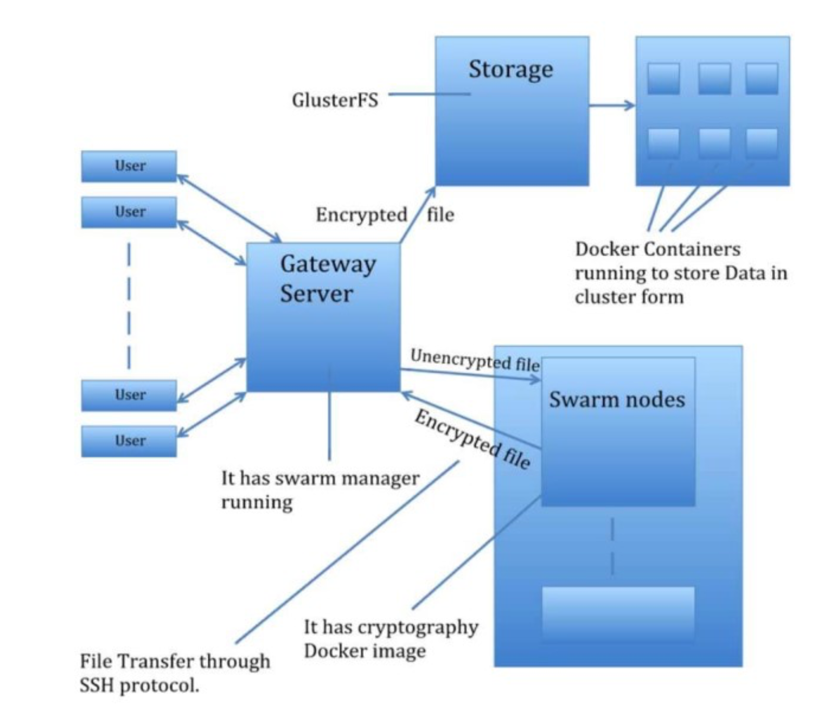

Slide 24
SWARM MODEL
Docker

Slide 25
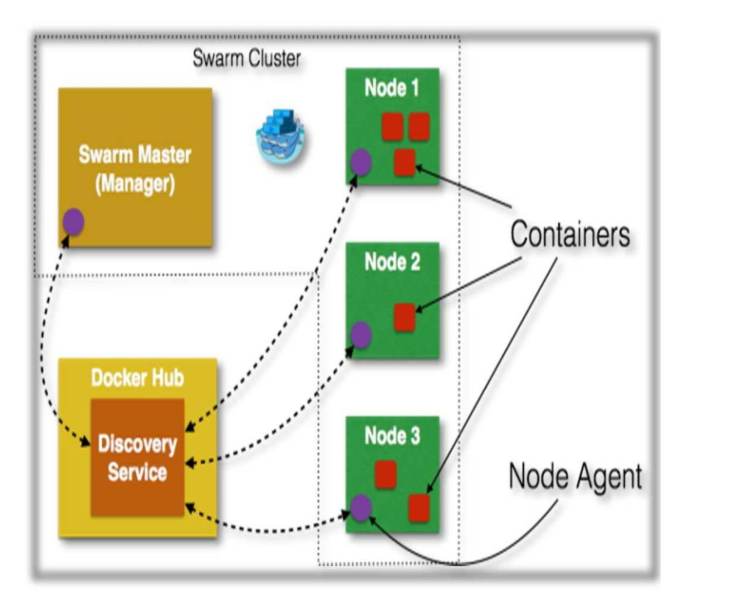

Slide 26
USIng kubernetes instead of docker swarm
Techniques to secure data on cloud
More efficiency.
Better power, performance and flexibility in container management.
Better optimisation for the existing model.

Slide 27
Conclusion
Conclusion
Cloud computing is very popular and cyber threats have also increased.
So securing the cloud is a necessity.
The technology of containers is used to secure data that is being uploaded to the cloud.
For each user a container can be used to manage encryption / decryption of user data.
Kubernetes is better for this model due to its shear strength.

Slide 28
Thank You

